Slide 1
Front End Engineering-I Project
Team Members : Diksha Vadehra
Tathya Sachdeva
Aneet Kaur
Faculty Coordinator: Mr. Deepak Kumar
Chitkara University Institute of Engineering and Technology,
Chitkara University, Punjab

Slide 2
Table of Contents
Introduction
Problem Statement
Technical Details
Key Features
Project Highlights
Conclusion
References/Links used

Slide 3
Introduction
Tribute Page
The purpose of this project report is to outline the development process and key components of tribute page website. The tribute page is designed to honor and commemorate Bill Gates, highlighting his achievements, contributions and impact. This provides an overview of the technical aspects involved in creating such a website.
The project focuses on utilizing HTML & CSS to develop a visually appealing and functional tribute page. The report highlights the steps involved in structuring the HTML, applying CSS styling, and implementing responsive design to ensure accessibility across different devices.
Additionally, the report emphasizes the importance of content creation and organization for an effective tribute page. It discusses strategies for gathering relevant information, selecting appropriate images, and presenting facts or quotes to create a comprehensive tribute.

Slide 4
Problem Statement
The website aims to create a dedicated online space that provides a comprehensive and engaging tribute to Bill Gates. The tribute page represents the challenge of creating a compelling digital platform that not only educates and informs but also pays a tribute to Bill Gates thereby contributing to the preservation of his legacy for generations to come providing a clear direction for the development process.

Slide 5
Technical Details
Software
Visual Studio Code
Language
HyperText Markup Language (HTML)
Cascading Style Sheets (CSS)
Hardware
Intel(R) Core (TM) i5-1035G1 CPU @ 1.00GHz 1.20 GHz
Graphic Card GEFORCE GTEX
SSD 512GB
RAM 8.00GB
Internet Connection
Wifi 50 mbps

Slide 6
Key Features
Subject Selection: Meticulous process of selecting a subject with substantial influence in their respective field ensuring that the legacy alliance with the project’s goals have inspiration and education.
Content Compilation: Thorough research and verification of information to present a comprehensive overview of Bill Gates lives achievements and contributions along with cultural and historical content in which they thrived.
Interactive Elements: Engaging multimedia components image calories and links to external resources to provide a dynamic and immersive experience for users.
Responsive Design: Ensuring seamless accessibility across various devices including desktop, laptops, tablet and mobile phones to cater to a diverse audience.
Source Verification: Rigorous citation and validation of all information and media used in the website content to uphold the highest standards of accuracy and integrity.

Slide 7
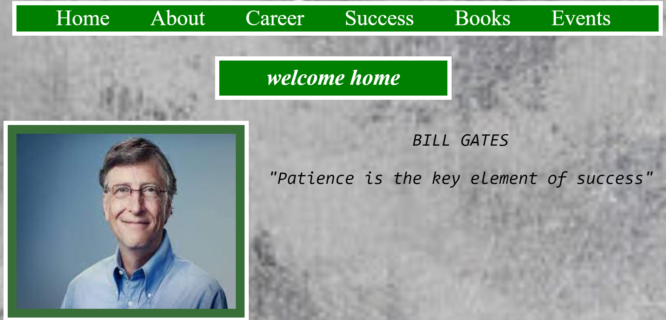
Project Highlights

Slide 8
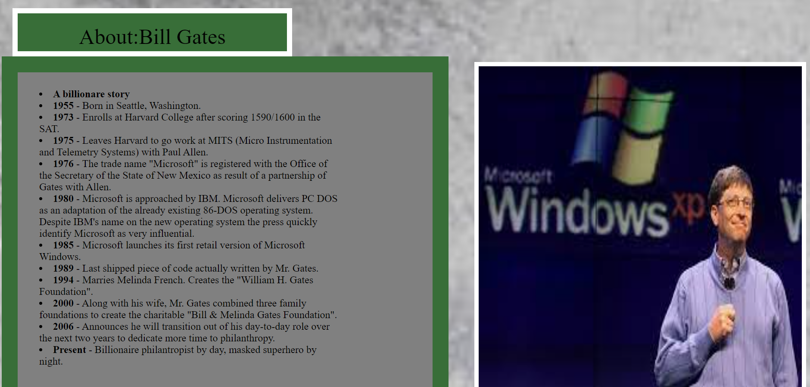

Slide 9
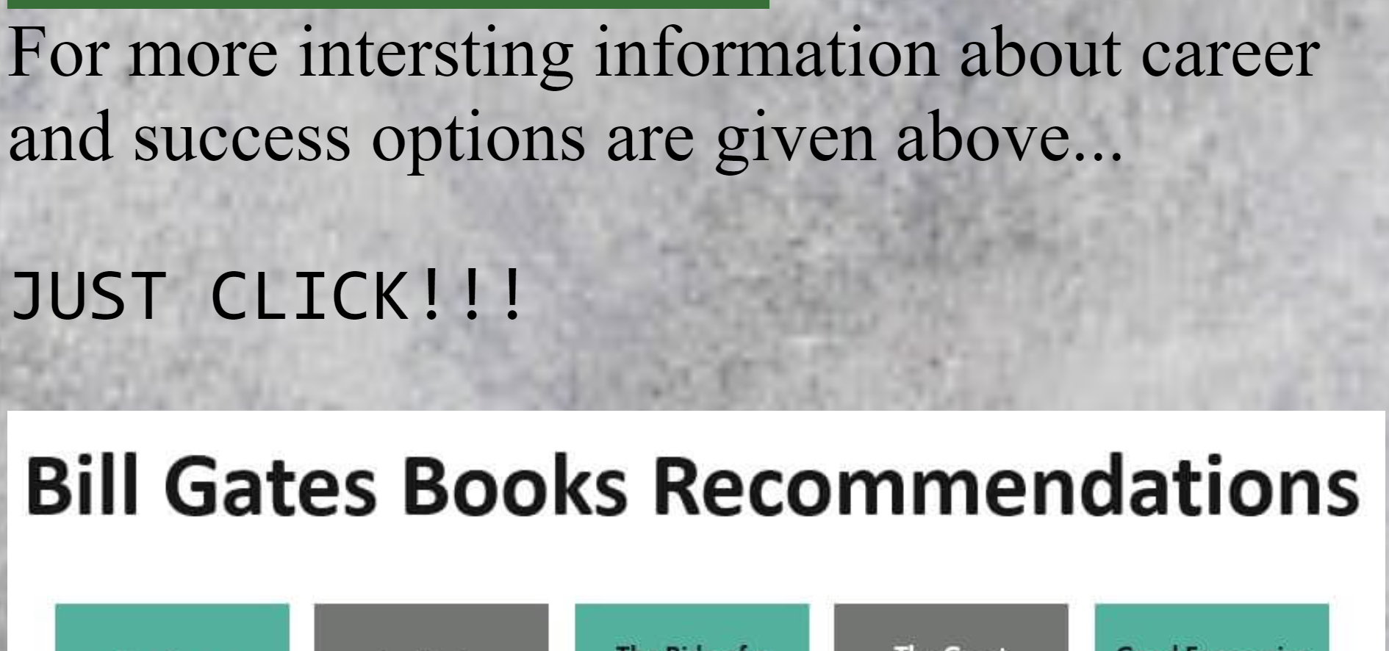

Slide 10
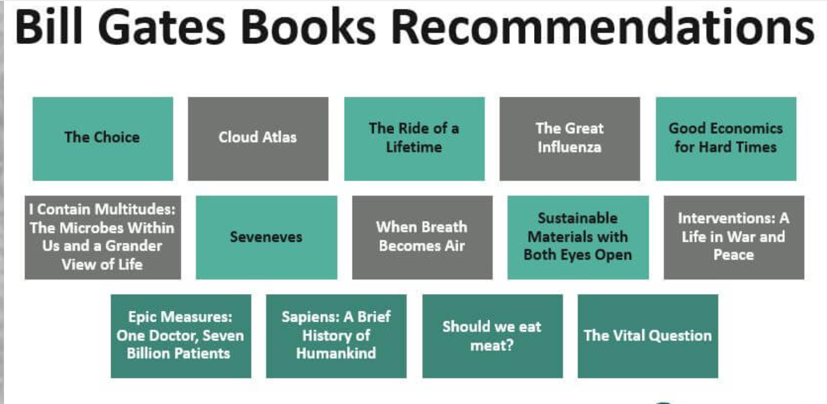

Slide 11
Conclusion
This website aims to provide a comprehensive understanding of the technical and design aspects involved in creating tribute page website. By following the outlined steps and guidelines, it is possible to develop an engaging and meaningful tribute page that effectively honors Bill Gates.

Slide 12
References/Links used
www.google.com
www.wikipedia.com
www.behance.net
Visual Studio Code
www.youtube.com

Slide 13


